Slide 1
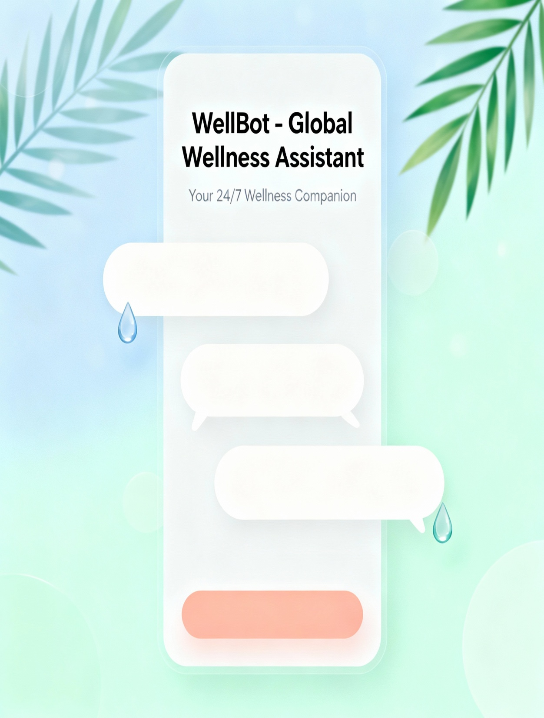
WELLBOT
User: Can’t sleep..!!
WellBot: Try deep
breaths.
User: Thanks, friend.

Slide 2
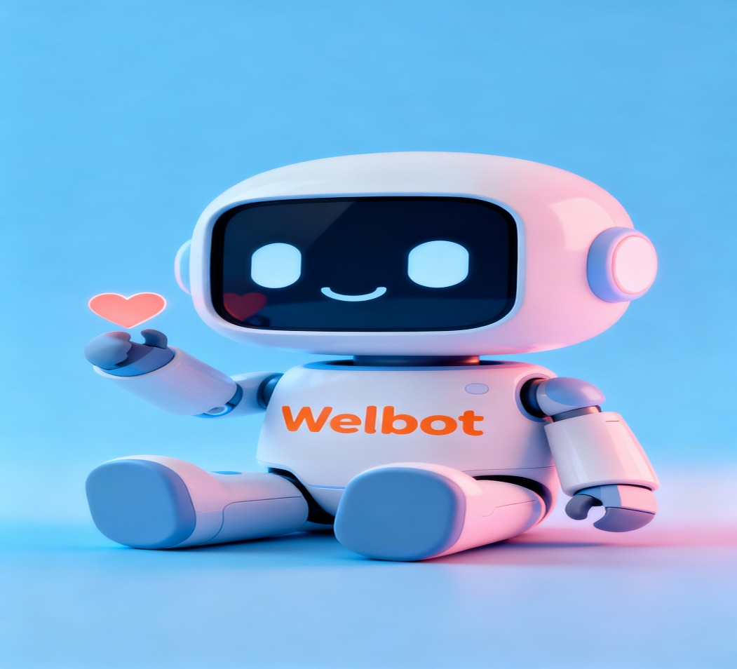
WELLBOT – Global Wellness Assistant Chatbot
Presented by:
1- Harsha Priya
2- Niharika
3- Suresh
4- Sumalatha
Under the guidance of :
Mrs. Santhiya Krishnasamy

Slide 3
Introduction
WellBot is a multilingual, AI-powered chatbot designed to promote global wellness.
It democratizes access to reliable, non-diagnostic health and self-care information.
By combining conversational AI with personalized insights, it empowers proactive health management.
The assistant focuses on improving accessibility, engagement, and awareness in wellness.
Its goal is to bridge technology and human well-being through seamless conversation.

Slide 4
Abstract
WellBot is an AI/ML-driven chatbot acting as a 24/7 wellness guide.
It consolidates advice on fitness, diet, sleep, and mental health into one interface.
Using NLP and Machine Learning, it provides context-aware recommendations.
The hybrid recommendation engine ensures personalized wellness guidance.
It bridges the gap between clinical expertise and daily self-care.

Slide 5
Problem statement
People often rely on scattered or unreliable online health information.
There is a need for a trusted, real-time wellness assistant that provides accurate, WHO-based guidance in a simple and accessible way.
A unified digital companion like Welbot can centralize evidence-based advice, reducing confusion and misinformation for users seeking help with their health and habits.
By offering personalized, conversational support, a wellness assistant chatbot can empower people to make informed decisions and build sustainable, healthy routines in their daily lives.

Slide 6
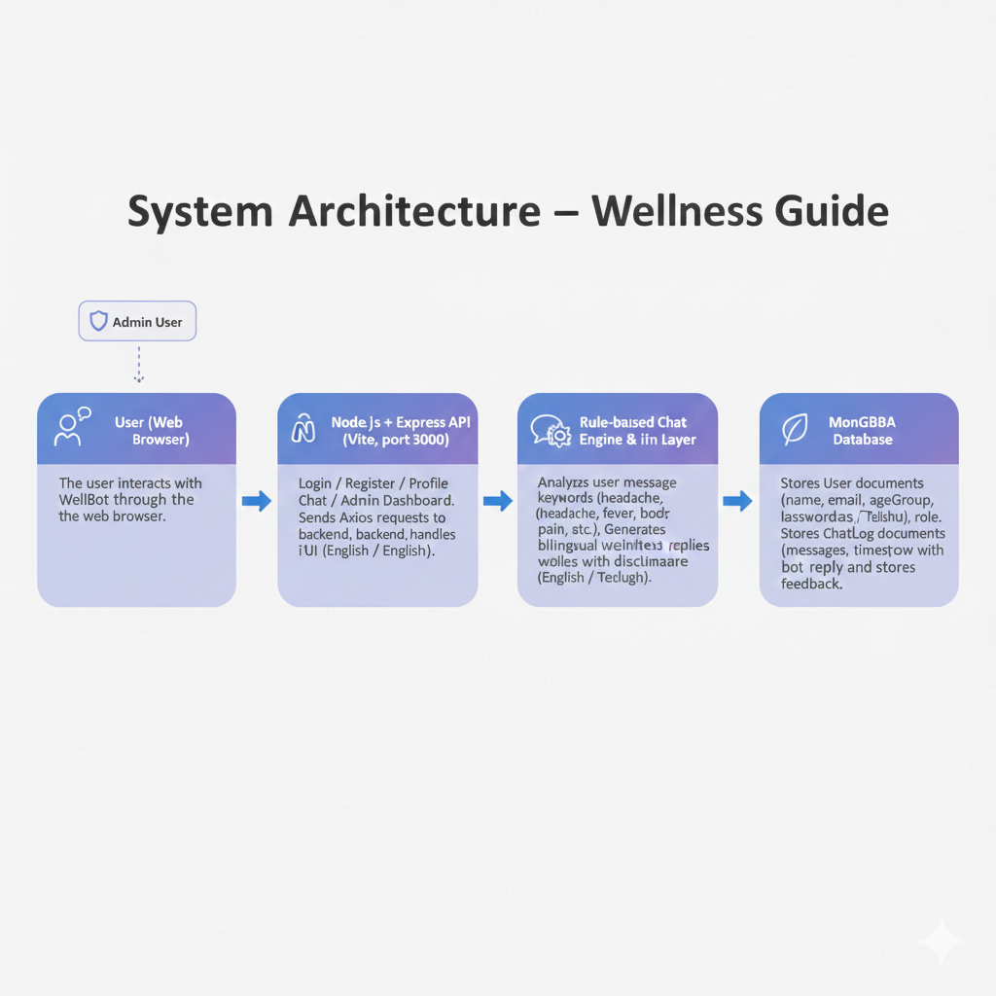
System Architecture

Slide 7
Milestone 1 – Authentication & Profiles
Created secure user registration and login using React, Node.js, and MongoDB.
Used JWT tokens and bcrypt to protect user sessions and passwords.
Stored user details like age group, language, and email in the database.
Built this as the base for personalized chat and wellness features.

Slide 8
Milestone 2 – Chatbot Integration & Web UI
Integrated the chat interface with Node.js backend and React frontend.
Built a rule-based wellness chatbot to respond to user health and diet queries.
Enabled bilingual support (English & Telugu) using i18n and language detection.
Stored all chat messages and sessions in MongoDB (ChatLog collection).
Added like, dislike, and comment features for each bot response.

Slide 9
Milestone 3 – Advanced NLP & Multilingual Features
Expanded the wellness knowledge base to 100+ topics (headache, fever, diet, sleep, stress, etc.) so replies cover more user scenarios.
Implemented safety-first responses and clear medical disclaimers in every reply.
Added and stabilized Telugu bilingual support (i18n + Telugu script handling) and automatic language detection from input.
Upgraded the rule engine with improved keyword/pattern matching and simple entity extraction for more context-aware replies.
Built a feedback loop (like / dislike + comments) to collect user signals for future improvements and analytics.

Slide 10
Milestone 4 – Admin Dashboard & Optimization
Built a secure Admin Dashboard for monitoring users, chat logs, and system activity.
Enabled admins to view sessions, messages, top questions, and export data (Users & Chats CSV).
Integrated feedback system results (likes, dislikes, comments) for quality analysis.
Optimized backend performance with better logging, session tracking, and error handling.
Improved UI with a clean, responsive, and mobile-friendly design for both admin and users.

Slide 11
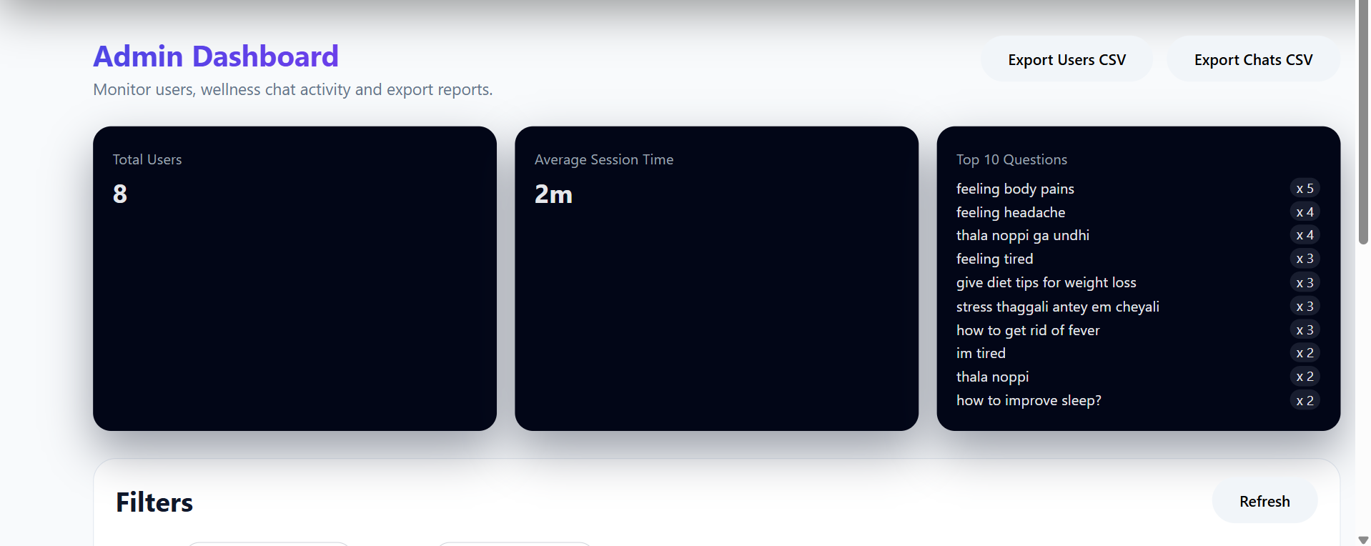

Slide 12
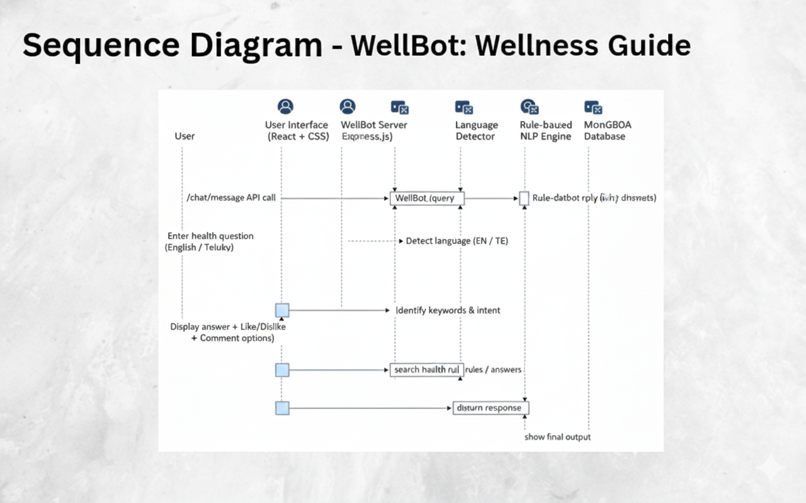

Slide 13
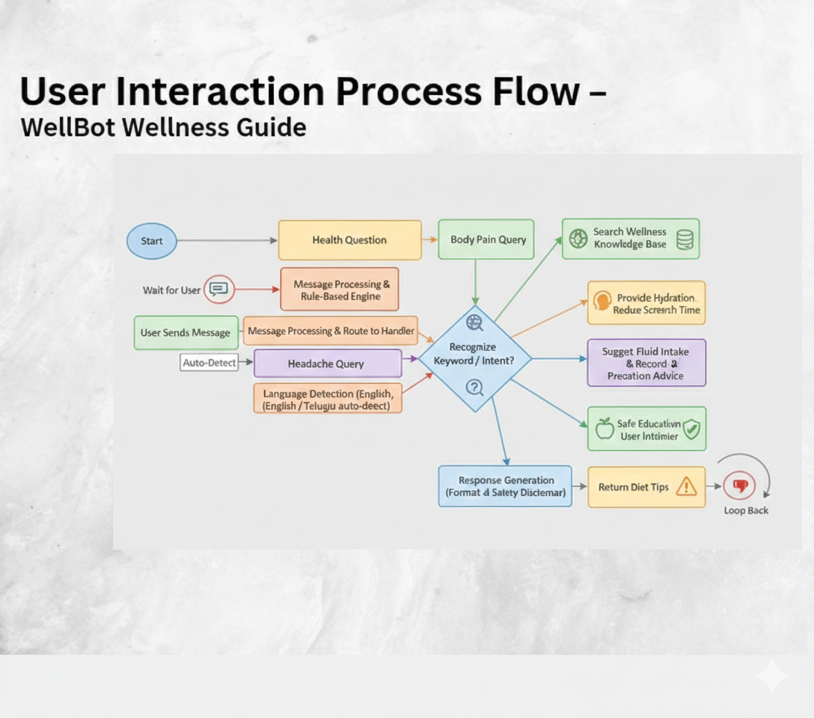
Module-1

Slide 14
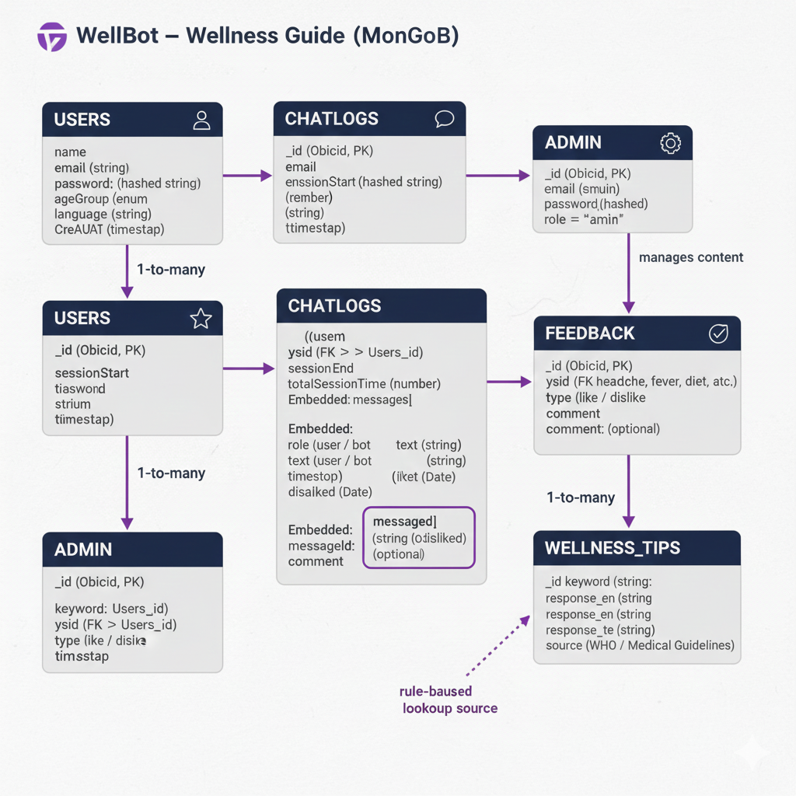
Module-1
MongoDB

Slide 15
Technologies Used
1. Backend: Node.js + Express.js for API routing, chat processing, authentication, and admin services.
2. AI Engine: Custom rule-based NLP logic for health-related responses (English + Telugu), with WHO-inspired knowledge base guidelines.
3. Authentication: JWT-based secure login system for users and admins, with token validation.
4. Database: MongoDB with Mongoose ORM for storing users, chat logs, admin data, and feedback securely.
5. Frontend: React.js + Vite with HTML, CSS for interactive UI, chat interface, and admin dashboard.

Slide 16
Output – Expected Outcomes
Delivers personalized daily wellness plans (diet, fitness, sleep).
Provides stress and emotion-aware advice.
Increases engagement through intelligent interaction.
Scales globally with multilingual support and adaptive AI.

Slide 17
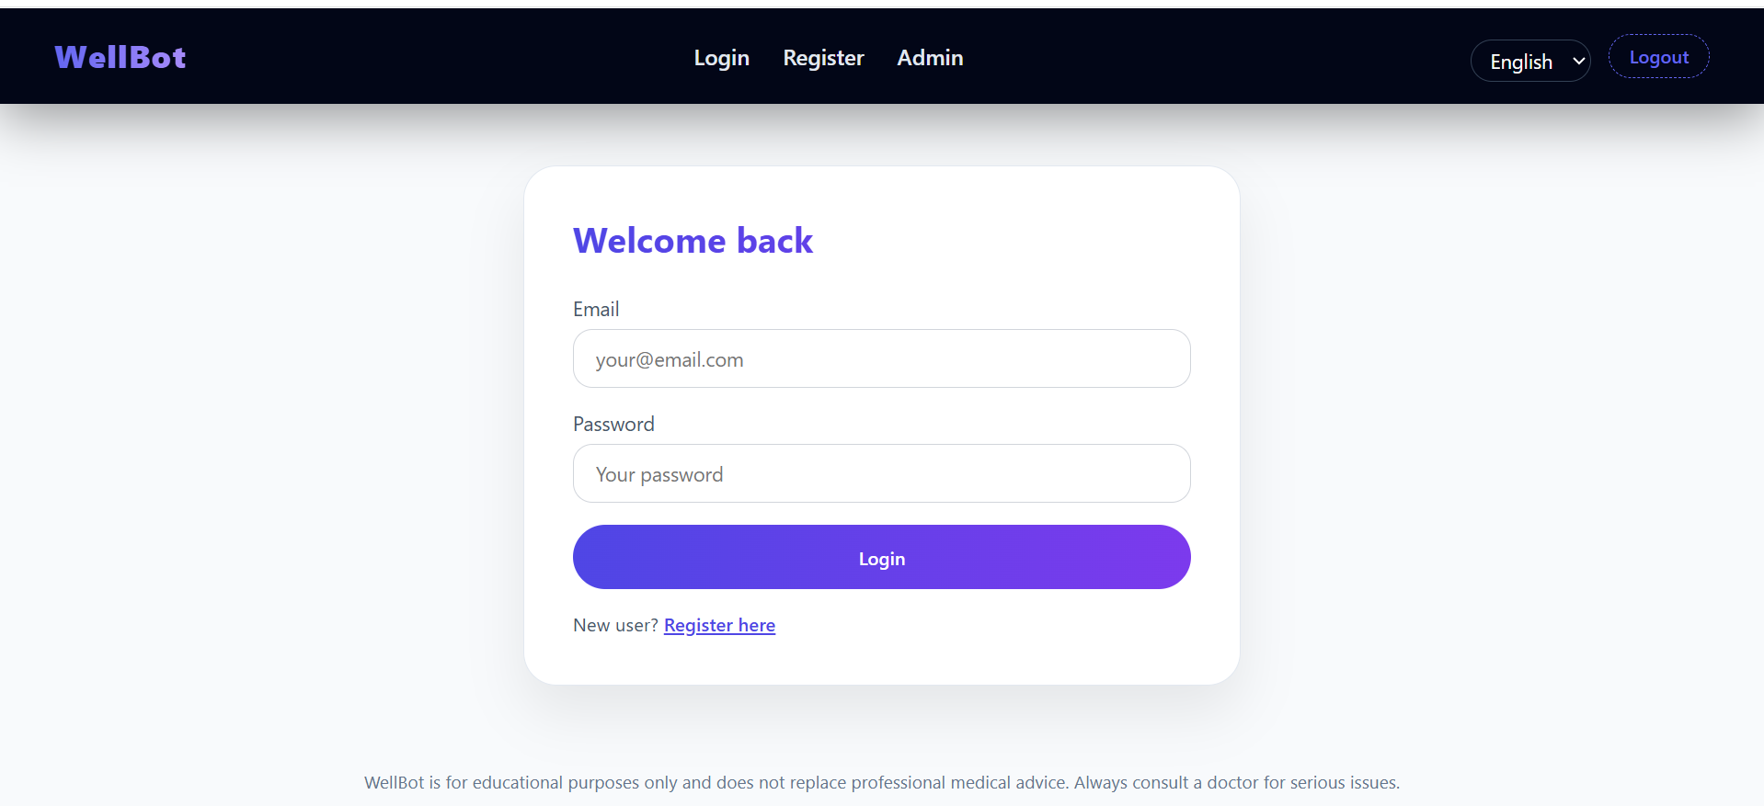
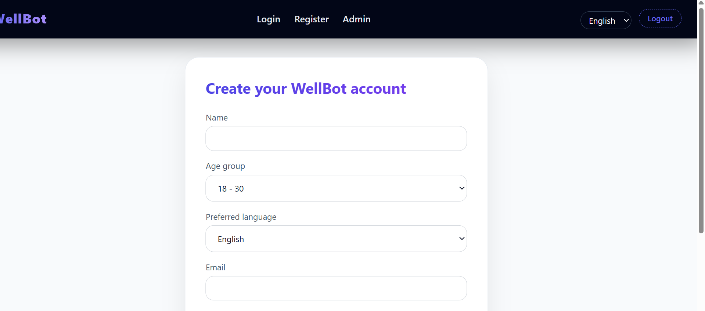

Slide 18
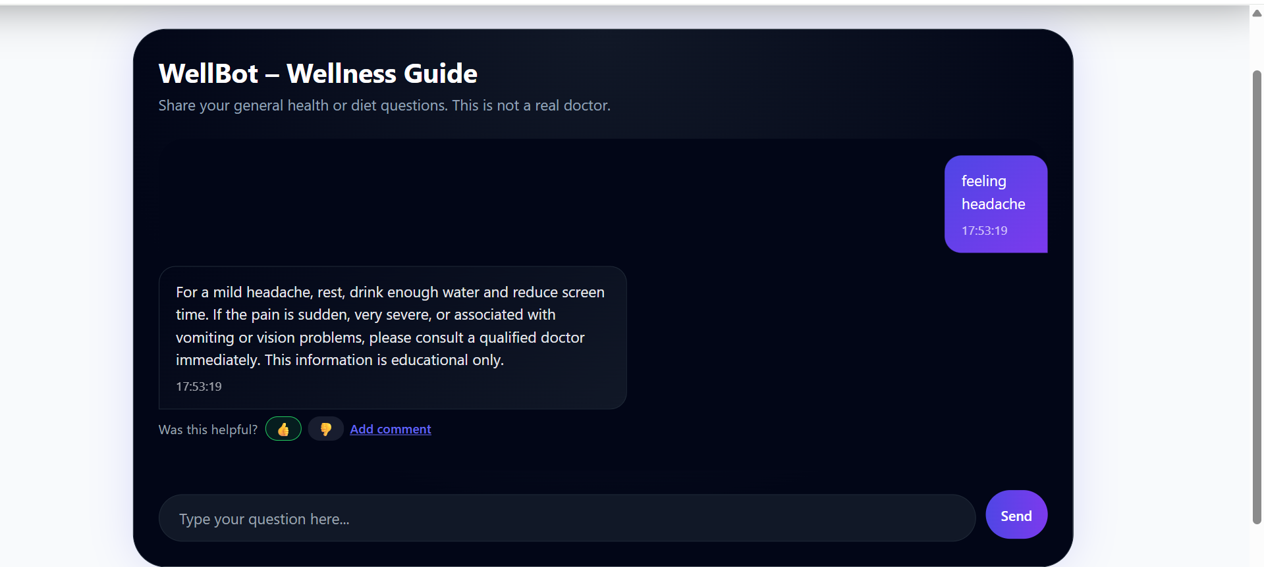

Slide 19
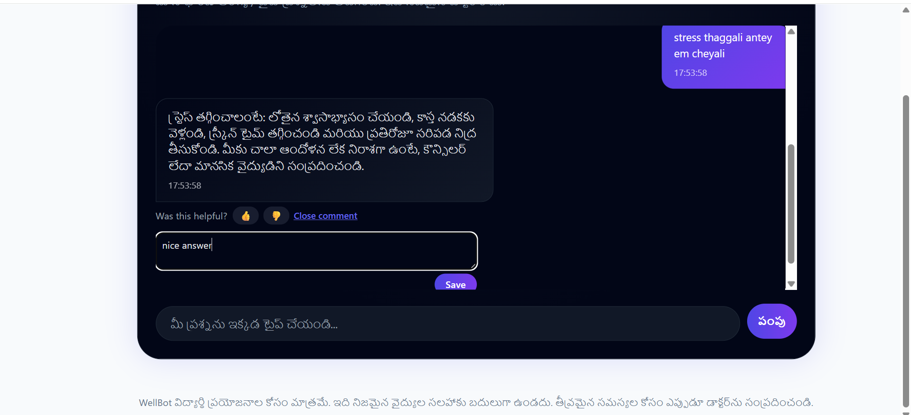

Slide 20
Future Scope
Introduce AR/VR meditation for immersive stress relief.
Enable AI-based image and voice diagnostics for early health checks.
Adopt blockchain for secure storage of sensitive health data.

Slide 21
Conclusion
WellBot demonstrates how AI can transform personal wellness.
It combines secure architecture with multilingual intelligence.
Supports self-care and awareness through accessible design.
Built with scalable, open-source technologies for growth.
Future versions will expand AI, security, and immersive health tools.

Slide 22
